Slide 1
VISUVALIZATION OF DATA

Slide 2
ABSTRACT
Data Analyzing and Visualization is an integral part of Data Analytics.
Filtration and sorting out relevant data out of a large amount is one of the most important parts of Understanding how different factors co-relate to each other.
In this project, we use Visualization and Data Analysis to make an average user easy (SARAL) to understand and access the data.

Slide 3
PROBLEM STATEMENT
Tabular information is more difficult to examine to get the desired statistics.
In some cases, it takes a longer time than anticipated to get the best-sorted facts.So, right here wherein records visualization comes into play.
It gives user-pleasant diagrams and makes users smooth to apprehend the information with high accuracy.

Slide 4
SYSTEM DESCRIPTION
The System consists of three modules :
Uploading
The user tabular data is been uploaded from here.
ii. Visualization
The data of user is been represented by each column in graphical format.
iii. Filtering
The user can see the pass percentage particular data in graphical format.

Slide 5
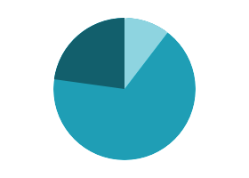

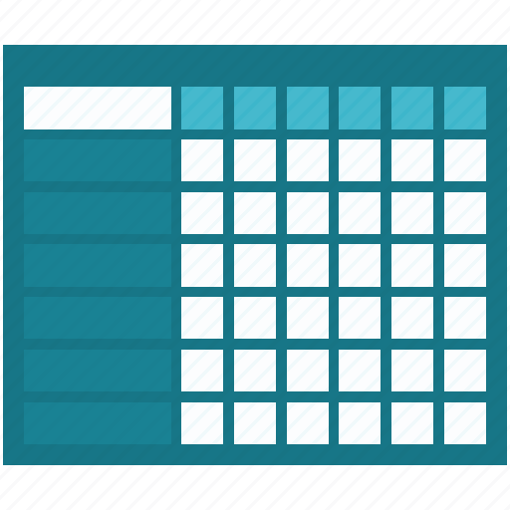


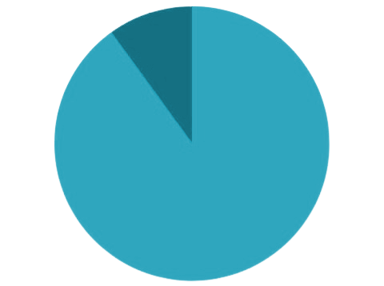
WORKING
Selecting Data
Visualizing Data
Table Data
Analyze Data
Filtering Data
Visualizing Data

Slide 6
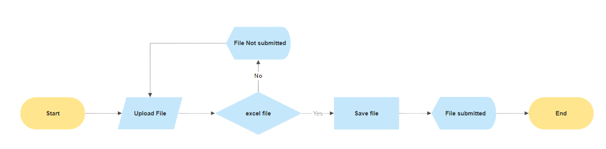
WORKING - UPLOAD
User receives a message when he uploads his data file and clicks the submit button. Then he will know that the file was successfully uploaded.

Slide 7
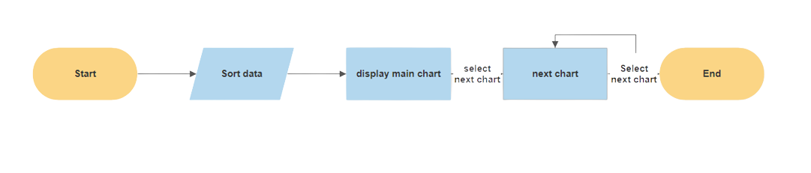
WORKING - VISUALIZATION
User is provided with the main pie chart with buttons. Then he can choose from factors of the chart what data they want to see next.

Slide 8
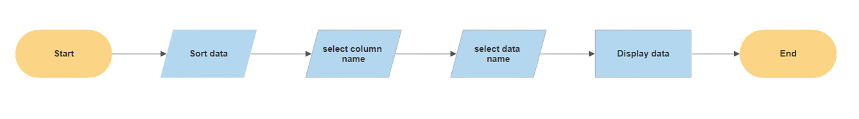
WORKING - FILTER
In order to analyze particular data, the user chooses a certain column of data he wants to analyze.

Slide 9
INSTALLATION
The folder contains a file named ‘run.bat’ run the file.
This runs django server and creates a virtual environment.
Open web-browser by searching in url http://127.0.0.1:8000/ or localhost:8000

Slide 10
SYSTEM REQUIREMENTS
SOFTWARE REQUIREMENTS:
Python
Django
HTML
Javascript
HARDWARE REQUIREMENTS:
Processor : 1.5 GHz
RAM : 2GB
ROM : 512 MB
OS : Windows

Slide 11
ADVANTAGES
Using simple graphs, helps the user to better understand the information.
Easy sharing of information.
Accurate analysis.
Finding relations between events.

Slide 12
LIMITATIONS
Data must contain same headings the same order as provided during implementation phase.
Requires an active internet connection.

Slide 13
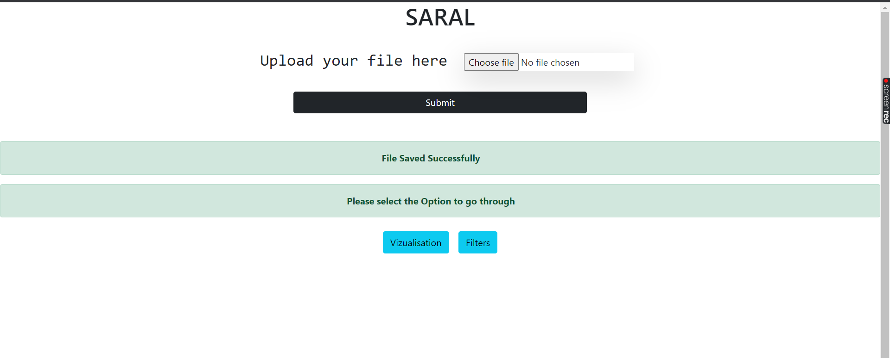
PREVIEW - UPLOAD

Slide 14
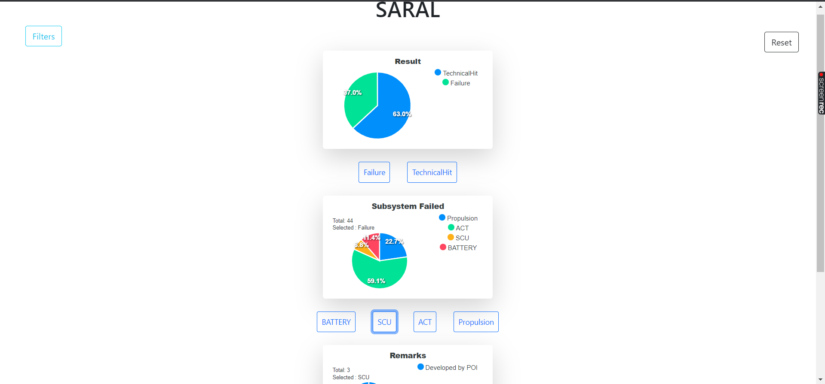
PREVIEW - VISUVALIZE

Slide 15
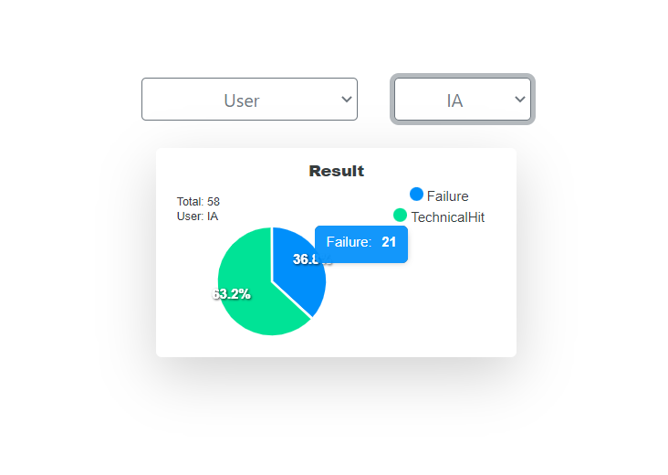
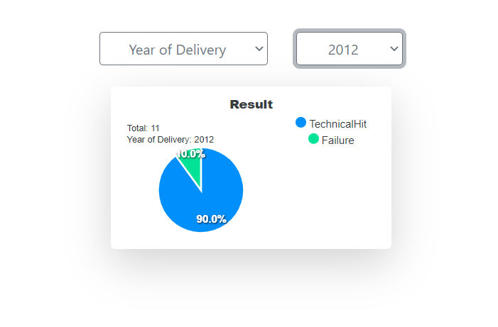
PREVIEW - FILTER

Slide 16
THANK YOU

